Slide 1
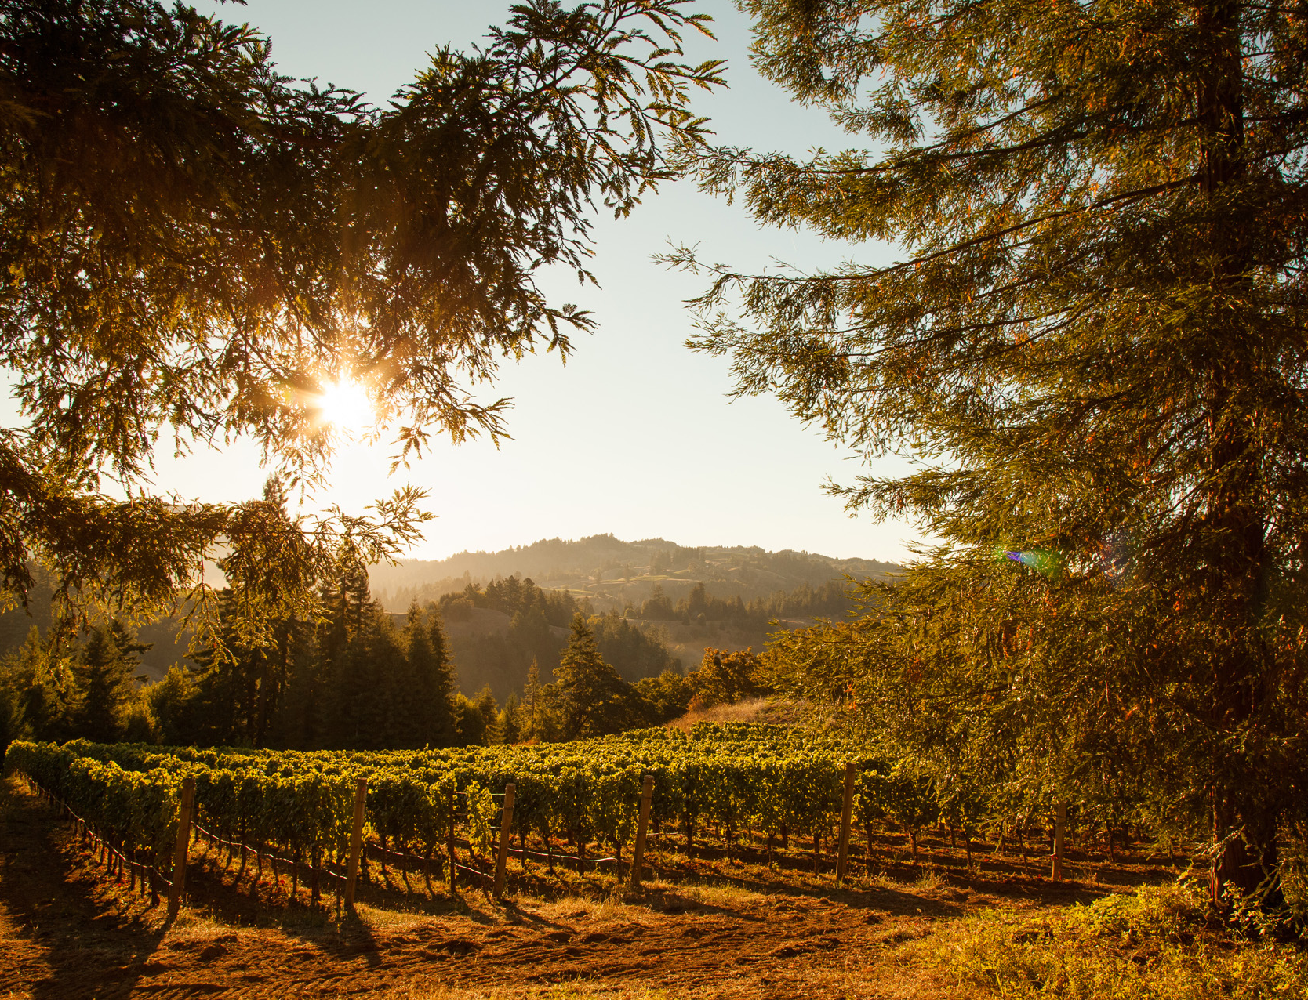
WINE HOOLIGANS LLC 980 Airway Court, Ste. A Santa Rosa, CA 95403 (707) 527-7355 winehooligans.com
Born out of friendship, a passion for wine, and a common love of Northern California.
About Us
Stephen Vincent was created in 2001 as a passion project of three friends. All wine industry veterans, the founders included La Crema winemaker Robert Goyette, prominent vineyard owner Hossein Namdar and Robert Mondavi executive Stephen Vincent Situm, who became the brand’s namesake. Their mission was clear – to create a portfolio of wines that showcase the best of Northern California, at price points that are accessible to everyone.
With their combined expertise, the trio found rapid success with their latest venture. Through the burgeoning community of winegrowers and producers in Sonoma County in the early 2000s, they began working with Dennis Carroll at his new bottling facility. Dennis went on to create Wine Hooligans with the vision of bringing artisan wines made by passionate winemakers to market. This was a perfect match for Stephen Vincent and its founders—once again bringing friends together through the brand.

Slide 2
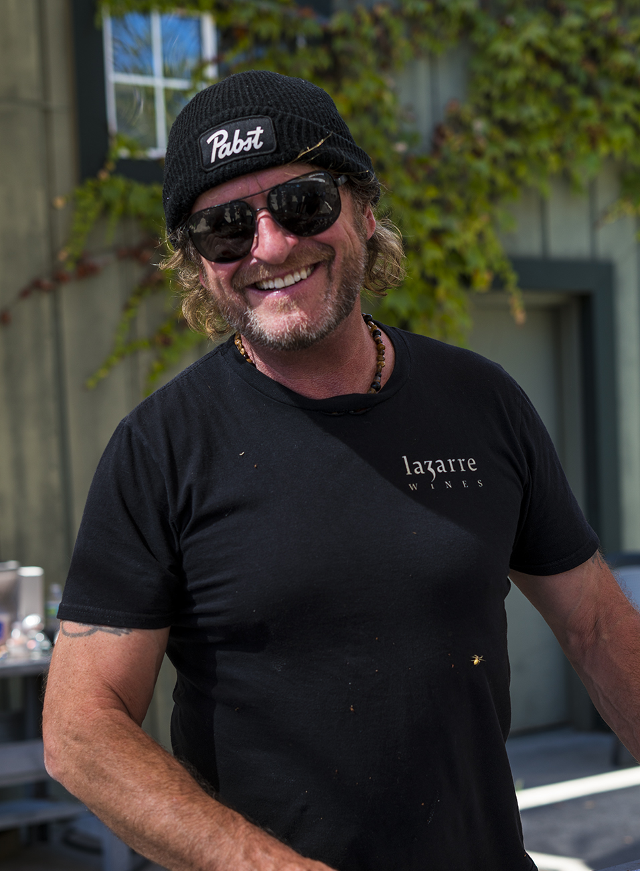
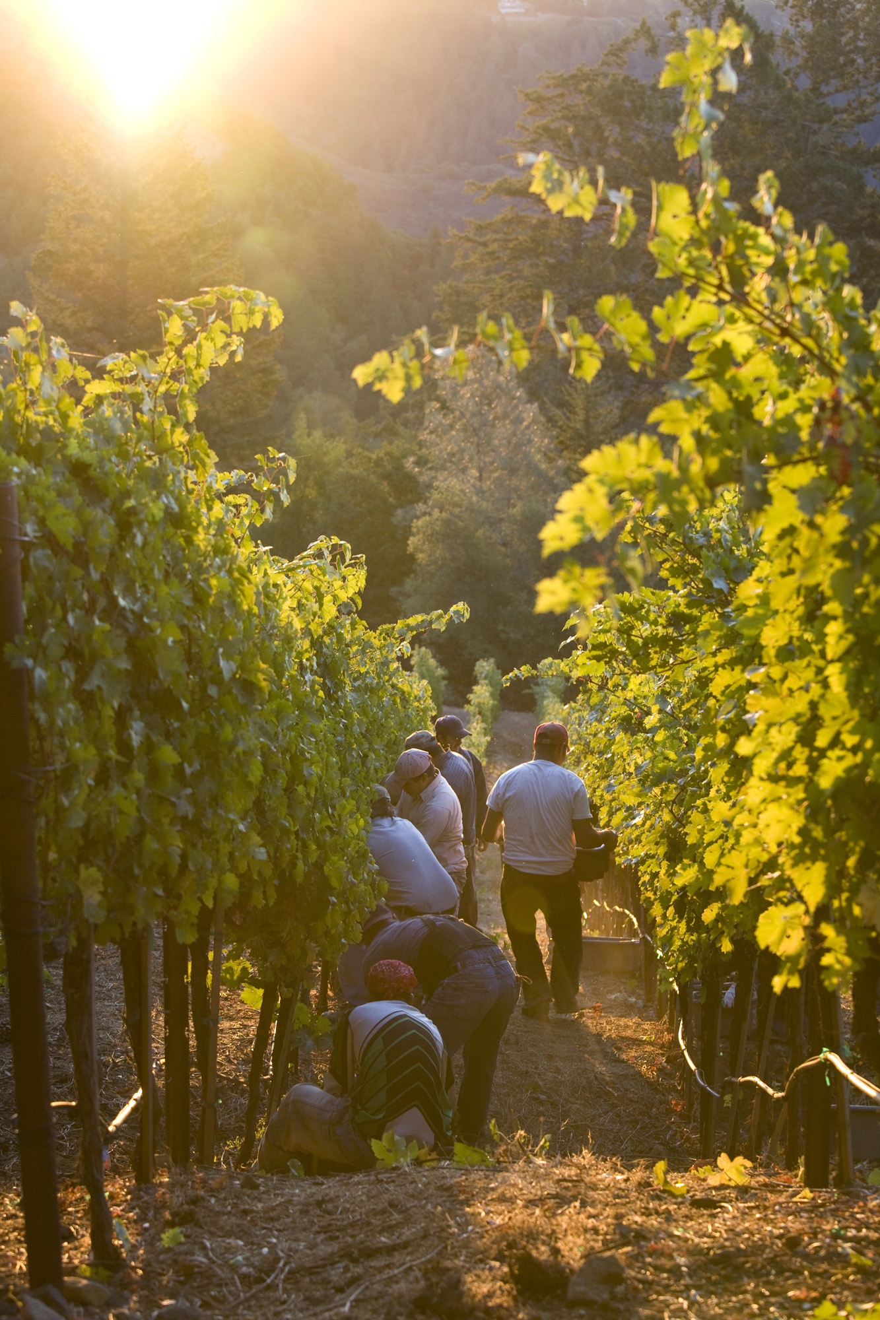
The wines of Stephen Vincent are sourced from some of the most prestigious regions in Northern California. Under the direction of award-winning winemaker Adam LaZarre, we partner with winegrowers dedicated to producing fantastic fruit vintage after vintage.
Here’s a sneak peak of our 2020 Napa Valley Harvest

Slide 3
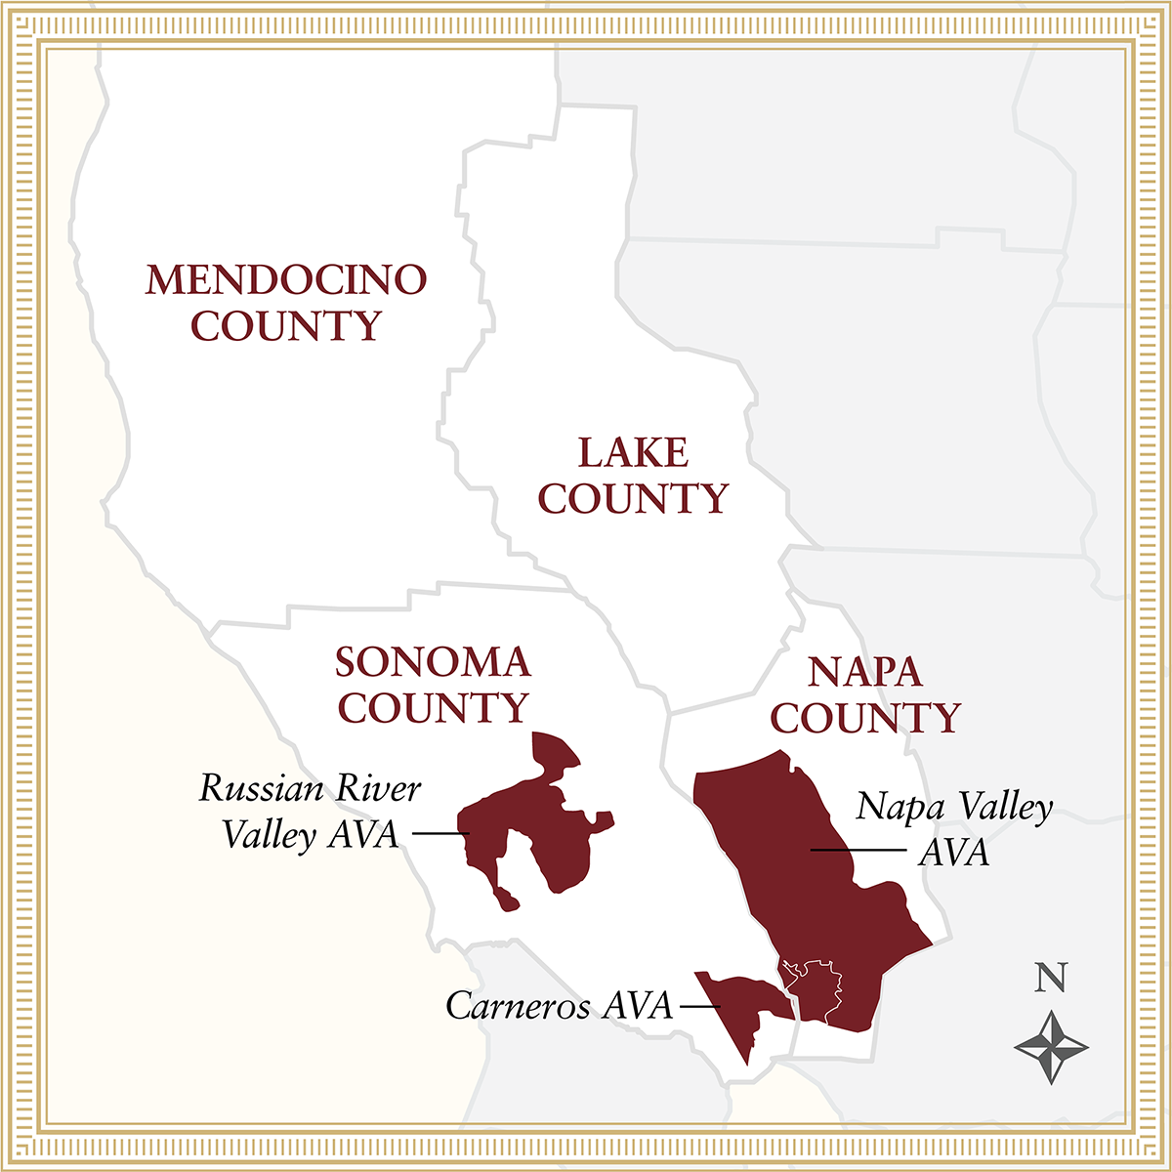
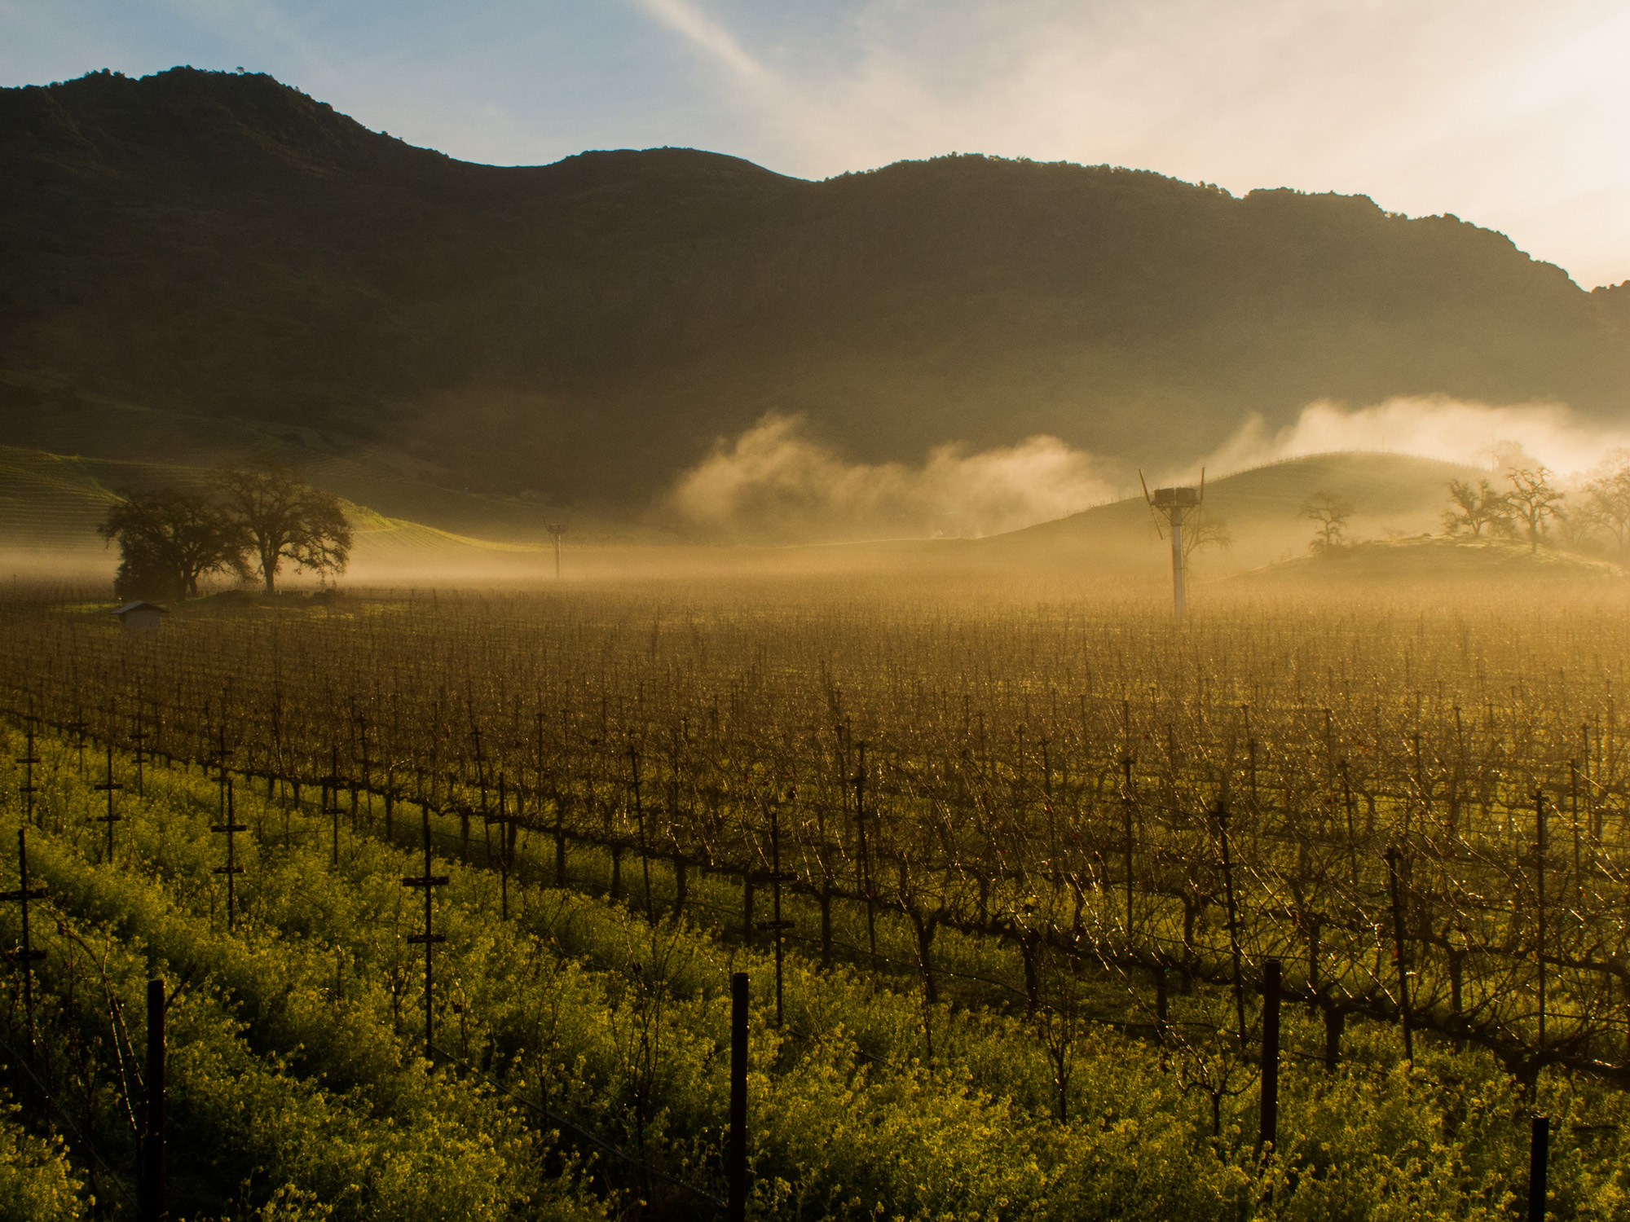
North Coast Sourcing
Our 2018 Pinot Noir and Chardonnay are sourced from acclaimed areas throughout Napa and Sonoma counties, such as the Russian River Valley and Carneros AVAs. These AVAs are known for success with these cool climate varietals, due to the maritime influence of the Pacific ocean. The Russian River Valley benefits from the cooling coastal fogs that come up through the Petaluma Gap, while Carneros receives early morning fog off the San Pablo Bay.
The 2018 Crimson Red Blend comes primarily from the Mendocino AVA. Within this large winegrowing regions, our vineyard sources benefit from warm microclimates that contribute to the production of bold, robust red varietals.

Slide 4
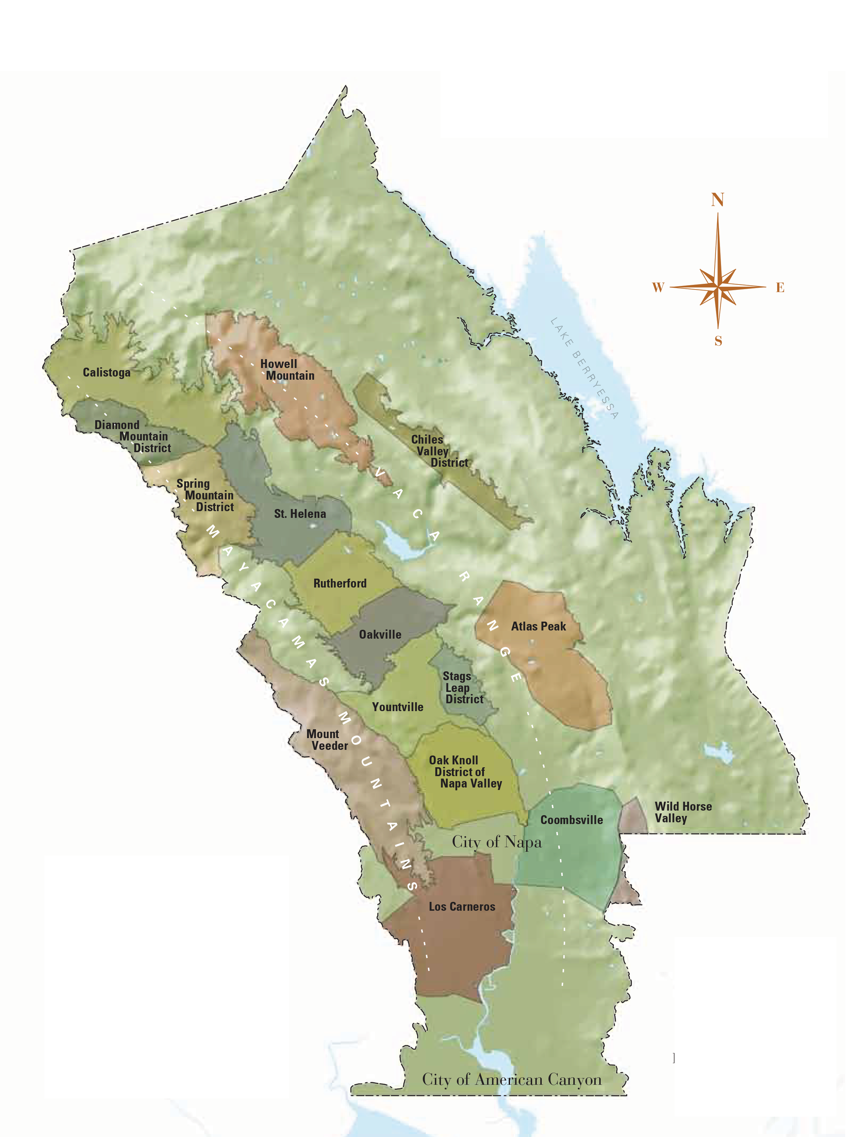
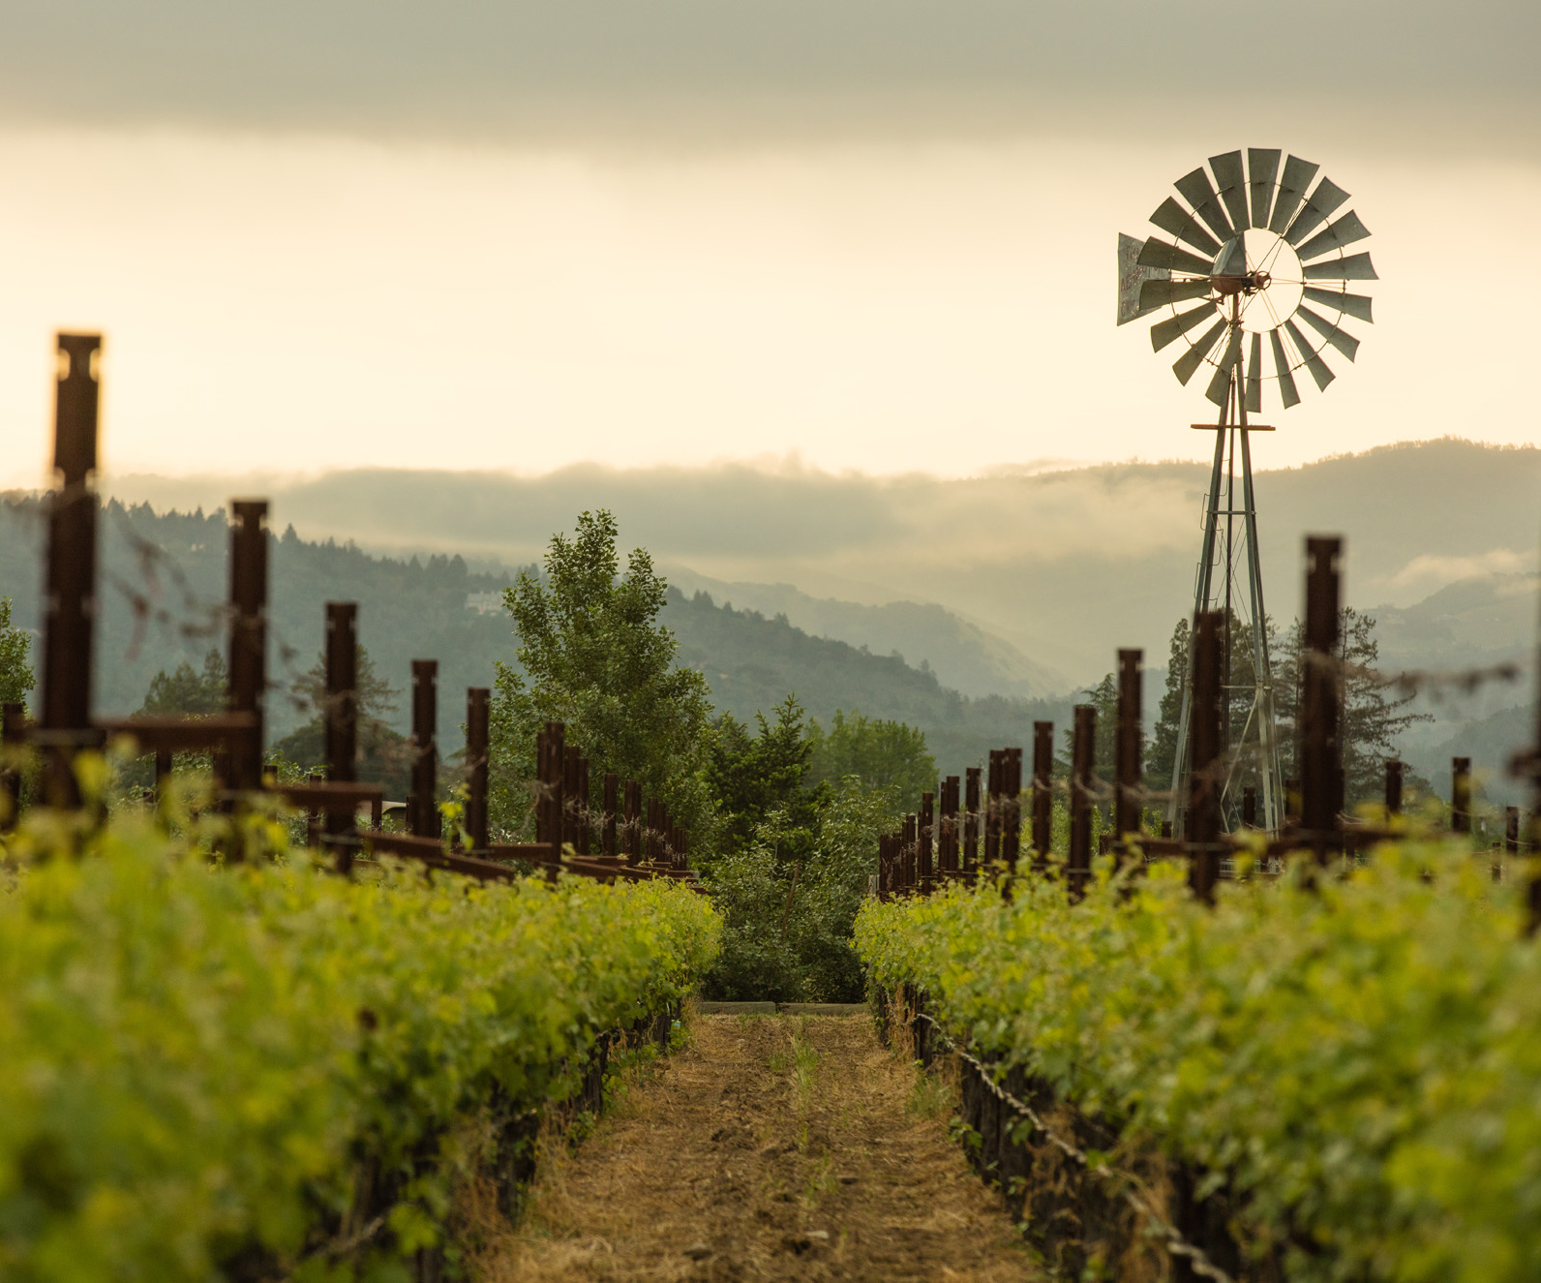
Napa Valley Sourcing
Our 2018 Cabernet Sauvignon is entirely sourced from Napa Valley, including the distinguished sub-appellations of Rutherford, Yountville and Oak Knoll. These world-renowned sub-appellations are dotted throughout the valley floor of Napa and are acclaimed for Cabernet Sauvignons of concentration, structure and depth.

Slide 5
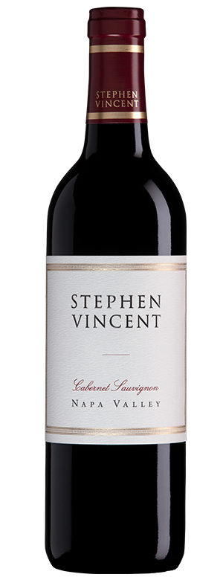
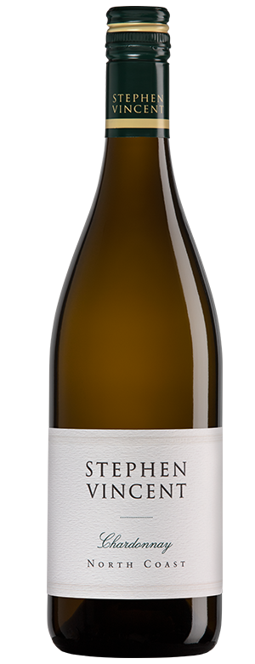
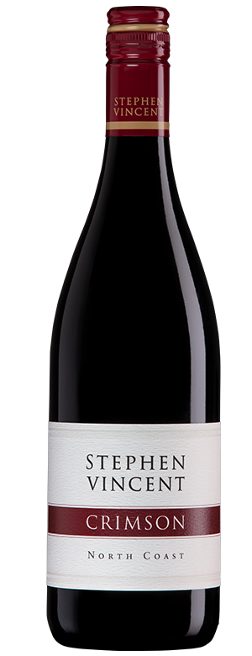
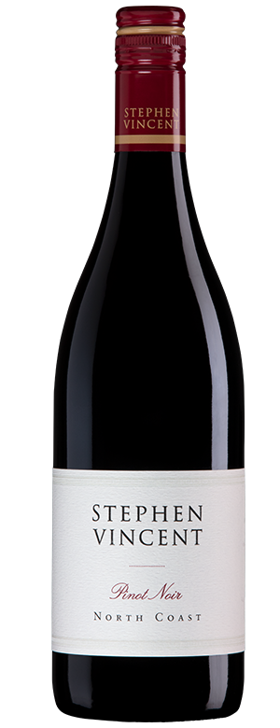
WINE HOOLIGANS LLC 980 Airway Court, Ste. A Santa Rosa, CA 95403 (707) 527-7355 winehooligans.com
Find tech sheets at the link below:
https://winehooligans.com/trade/?fwp_brand_filter=Stephen-vincent&fwp_asset_type_filter=tech-sheet

